Slide 1


Slide 2
What is Laravel?
Laravel Is free open source php web framework, used for development of web applications following the Model-View-Controller (MVC) architectural pattern.

Slide 3
Why Laravel
MVC support
Security & Authentication
Artisan Commands
Database Migration
Blade Template Engine
Eloquent ORM
Open Source Language

Slide 4
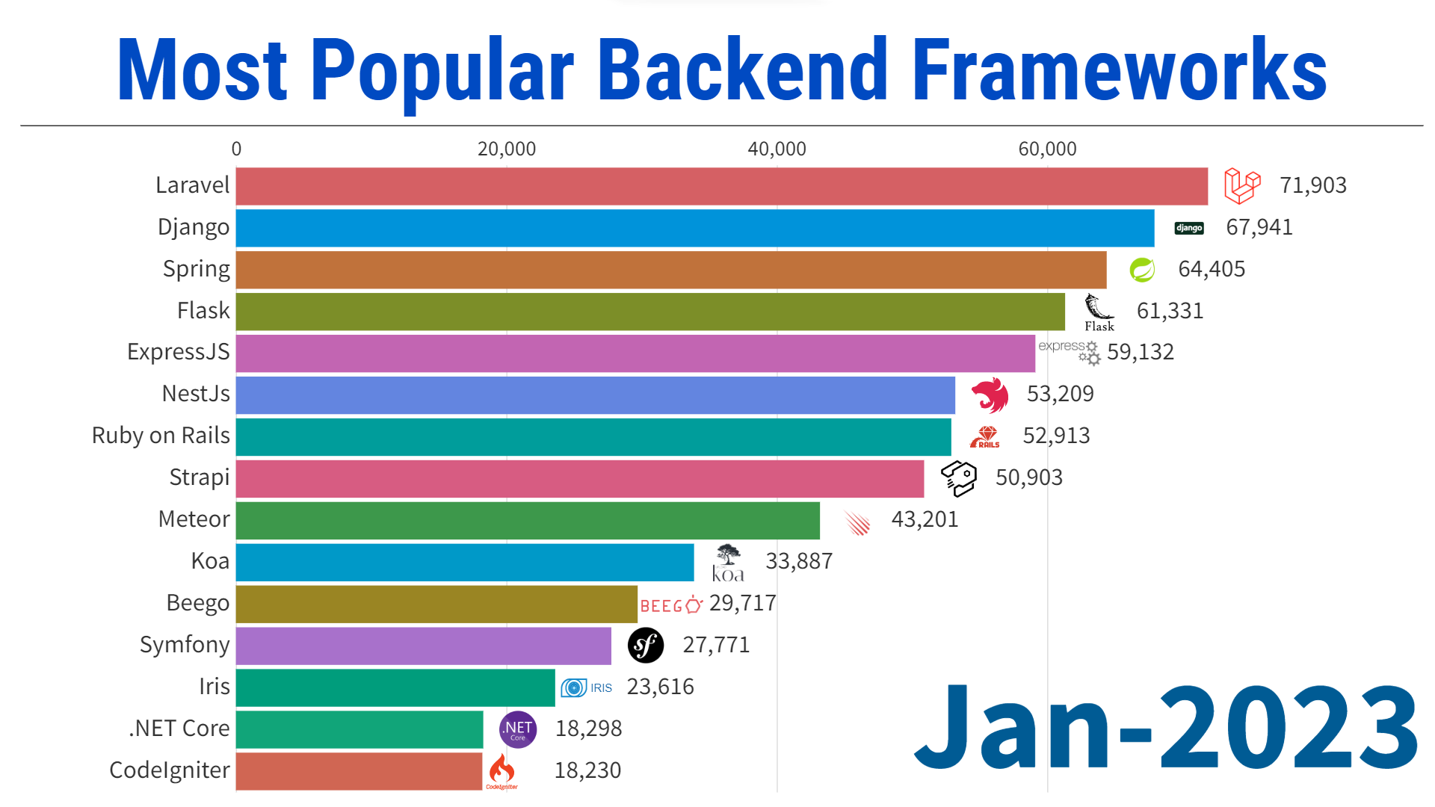

Slide 5
What is MVC in Laravel ?
The MVC pattern is a software design pattern that separates an application into three interconnected components: the model, the view, and the controller.

Slide 6
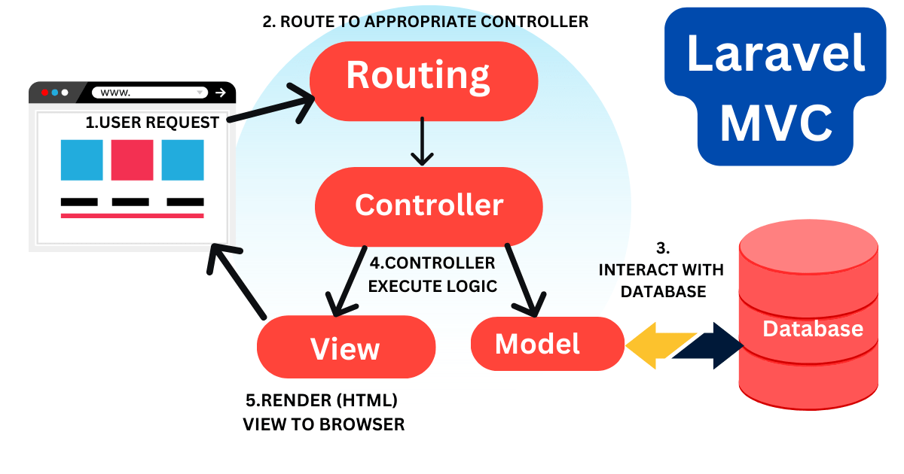

Slide 7
Model
Maintaining the data in the table and giving users a way to interact with it
Database Relation (app/Models/…)
Database Table (database/migrations/…)

Slide 8
View
Views contain the html code required by your application
Presentation logic
(resources/views/…)
(page.blade.php)

Slide 9
Controller
The controller is where you enter or code most of your application logic
Backend logic / functionalities
(app/Http/Controllers/…)

Slide 10
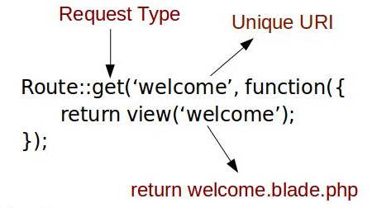
Route
A way of creating a request URL for your application
(routes/web.php)
(routes/api.php)

Slide 11
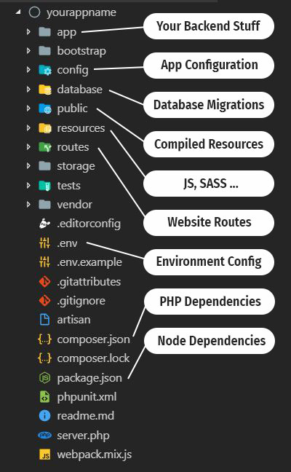

Slide 12
Requirements
Xampp
https://www.apachefriends.org/download.html
Composer
https://getcomposer.org/download/
Node
https://nodejs.org/en/download
Vs Code
https://code.visualstudio.com/download

Slide 13
Commands
Create project
composer create-project laravel/laravel ProjectName
Run project
php artisan serve
Make model and controller
php artisan make:mode ModelName -mcr
Migrate database
php artisan migrate
php artisan migrate:fresh
Clear Cache
php artisan optimize

Slide 14


Slide 15
Day 1
Overview of Laravel
Creating your first Laravel project
Understanding the directory structure
Setting up the development environment
“Hello World” in Laravel

Slide 16
Day 2
Introduction to routes and basic routing
Creating and working with controllers
Introduction to Blade templating engine
Creating and using Blade views

Slide 17
Day 3
Creating and migrating database tables
Creating controllers for CRUD operations
Creating view for the CRUD

Slide 18
Day 4
Implementing basic Create, Read, Update, and Delete functionality
Working with layouts and partials

Slide 19
Day 5
Quick overview of Laravel's authentication system
Implementing basic user authentication
Associating CRUD operations with authenticated users
Creating a Simple Blog App

Slide 20
Day 6
Completion of Blog App in Admin and User
Understanding of Api’s
Creating Simple Api’s

Slide 21

Day 7

